Slide 1
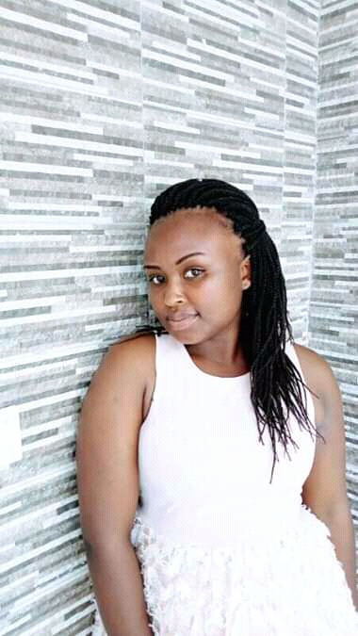
MFURANZIMA Nadette Software Engineering Student
Name: MFURANZIMA Nadette
Contact Info: Tel:+250732756855
Email: nadette827@gmail.com
LinkedIn Profile : https://www.linkedin.com/in/nadette-mfuranzima
City: Kigali-Rwanda
Personal Profile
Education Background
Major: Software Engineering.
Year of study: 2nd years.
Expectation to the Course: Database Automation Skill Automate repetitive tasks and enforce business rules using PL/SQL.
Use of Digital Information: Information Access: Searching for information online through search engines, reading news articles, or accessing eBooks and digital libraries.
Additional Information
What people don’t know about me: I love being around Animals , Cats Dogs but sometimes I fear them. and I know how to handle any situation

